Slide 1

MathWorks #2
Classifying Object Behavior to Enhance the Safety of Autonomous Vehicles
AI Studio Final Presentation
Break Through Tech AI Boston @ MIT
January 23, 2024

Slide 2

Introductions

Slide 3

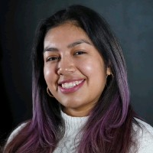
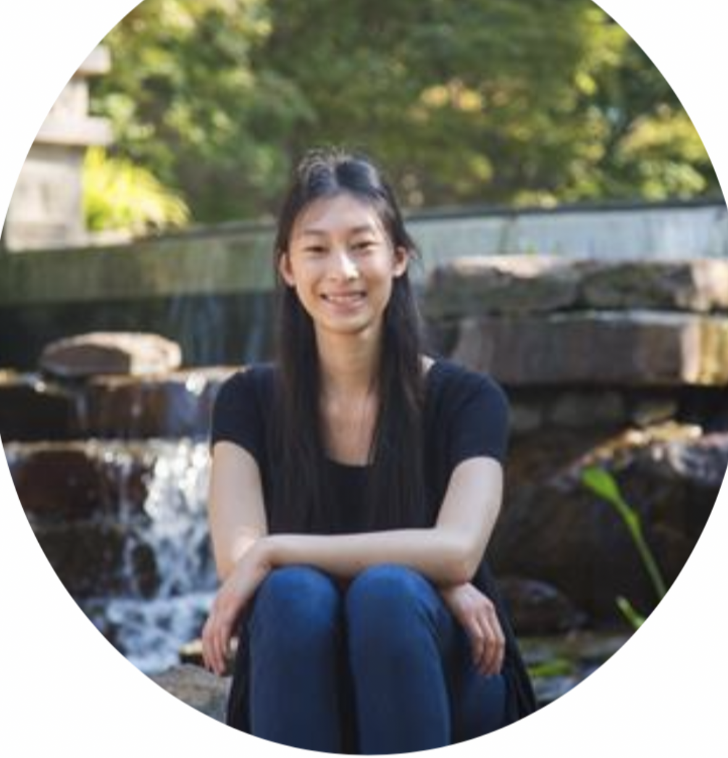

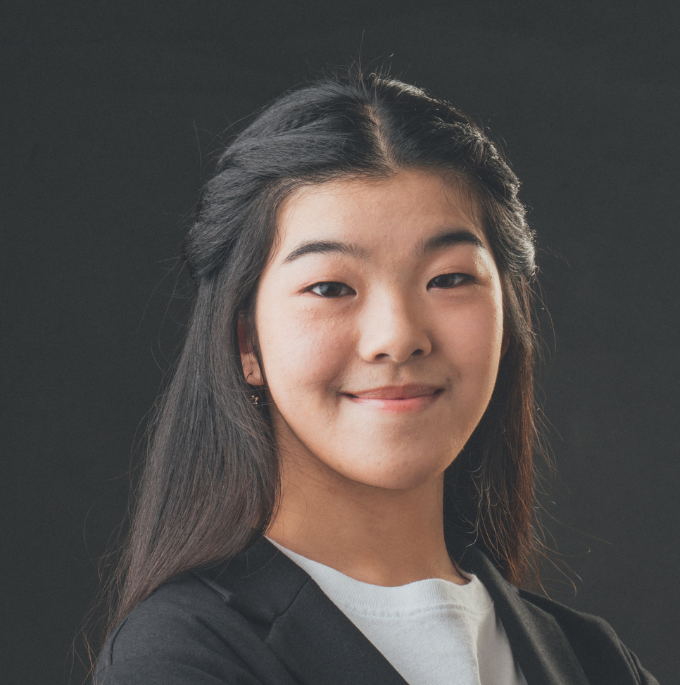
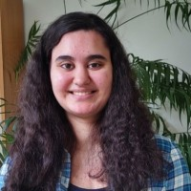

Meet Our Team!
<insert jpg>
<insert jpg>
<insert jpg>
Pamela Melgar Tufts University
Elena Wang Smith College
Kashish Gupta Worcester Polytechnic Institute
<insert jpg>
<insert jpg>
<insert jpg>
Rachel Ma Northeastern University
Vanessa Bellotti Tufts University
Nyah Lalimarmo Simmons University
Notes:
Pam -> Elena -> Kashish -> Rachel -> Vanessa -> Nyah

Slide 4
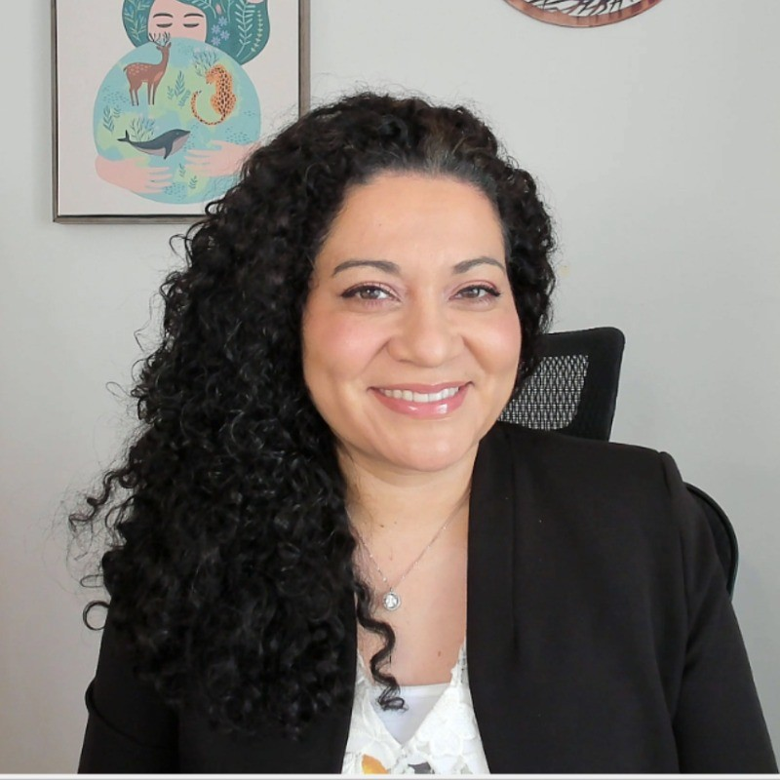

Our AI Studio TA and Challenge Advisor
Maria Elena Gavilan Alfonso Challenge Advisor
Keith Murray AI Studio TA

Slide 5
Presentation Agenda
Project Overview
Data Understanding and Data Preparation
Transfer Learning & Foundational Model
Model Training and Evaluation
Final Thoughts
Questions

Slide 6
AI Studio Project Overview

Slide 7
“
Fine-tuning the detection of pedestrians and cyclists near autonomous vehicles using Deep Learning (Transfer Learning)

Slide 8
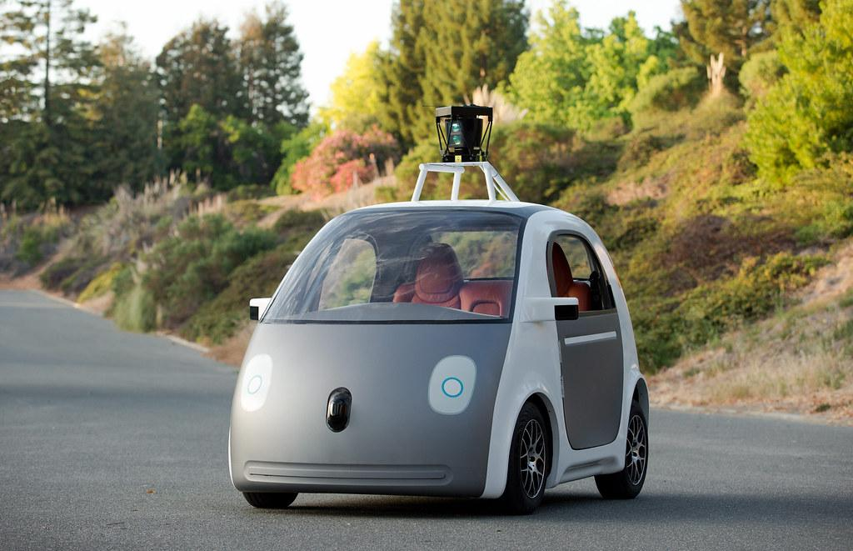
Business Impact
Increasing ‘public trust’ in self-driving cars
Insight into potential dangers
Potentially smoother driving, better identification
Accurate object detection = safe critical decisions
Transfer Learning is ‘cost-effective’
Cut costs of building model from scratch
Notes:
Motivation
Autonomous vehicles will transform transportation and change how we move around and receive goods. The safety of those systems is paramount. To be able to operate safely in a complex environment, the autonomous vehicle uses sensors to detect and track objects in its vicinity, for example pedestrians, bicyclists, and other vehicles. However, estimating the motion of objects around the autonomous vehicle is insufficient. The next level is for the autonomous vehicle to classify the behavior of the objects, whether safe or unsafe, with respect to it.
Consider the following EXAMPLES::
A safe driver that follows the rules of the road vs. an aggressive driver, such as changing lanes aggressively at various speeds that might pose a risk to the autonomous vehicle.
A pedestrian that walks safely by the side of the road vs. a young child chasing a ball that might suddenly start crossing the road. Classifying the behavior of tracked objects can help the autonomous vehicle to predict the motion of these objects and plan accordingly.
In 2020, there were over 2.1 million emergency department visits due to vehicle crashes

Slide 9

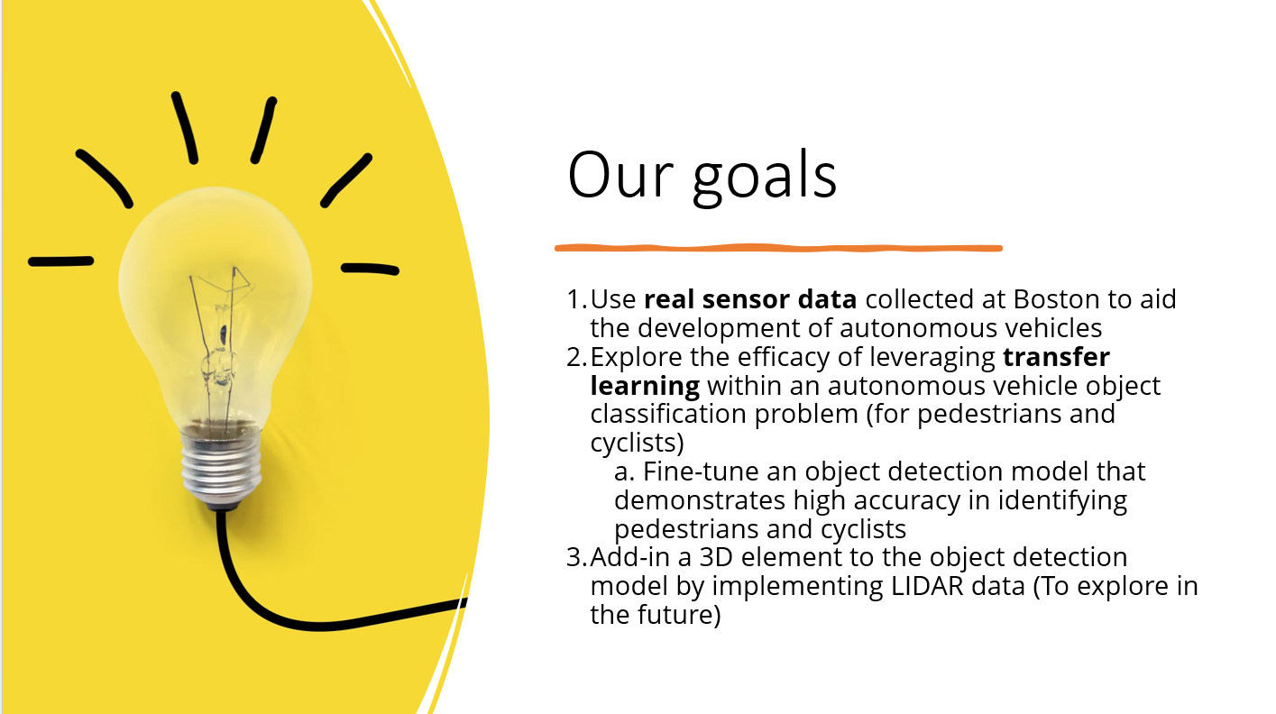

Slide 10
Our Approach
Data preparation
Explored nuImages data and created training and test sets
Training
Transfer Learning
Training Preparation
Downloaded TensorFlow pretrained models and explored the Object Detection API
Evaluation
Used metrics like precision and recall to fine-tune the model

Slide 11


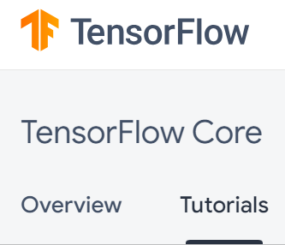
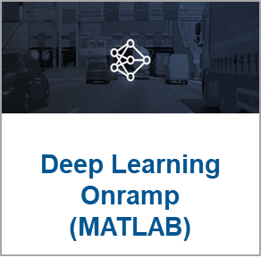


Resources We Leveraged
Training

Slide 12
Data Understanding & Data Preparation

Slide 13
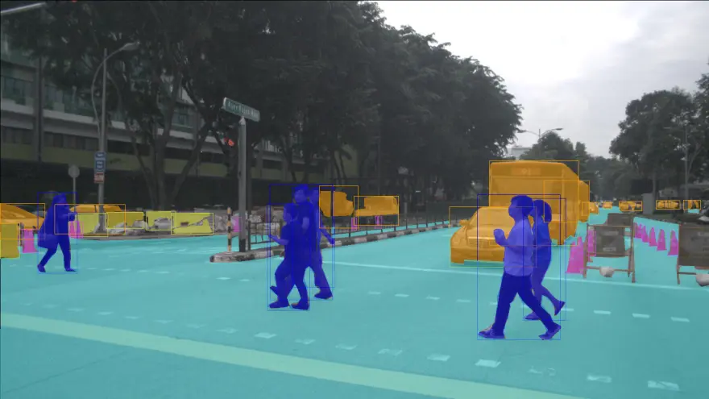
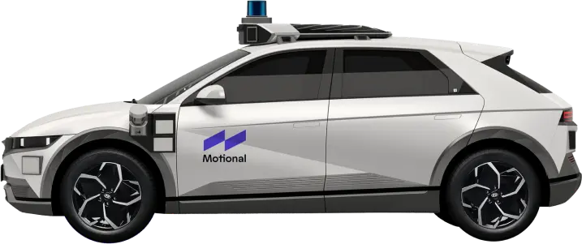
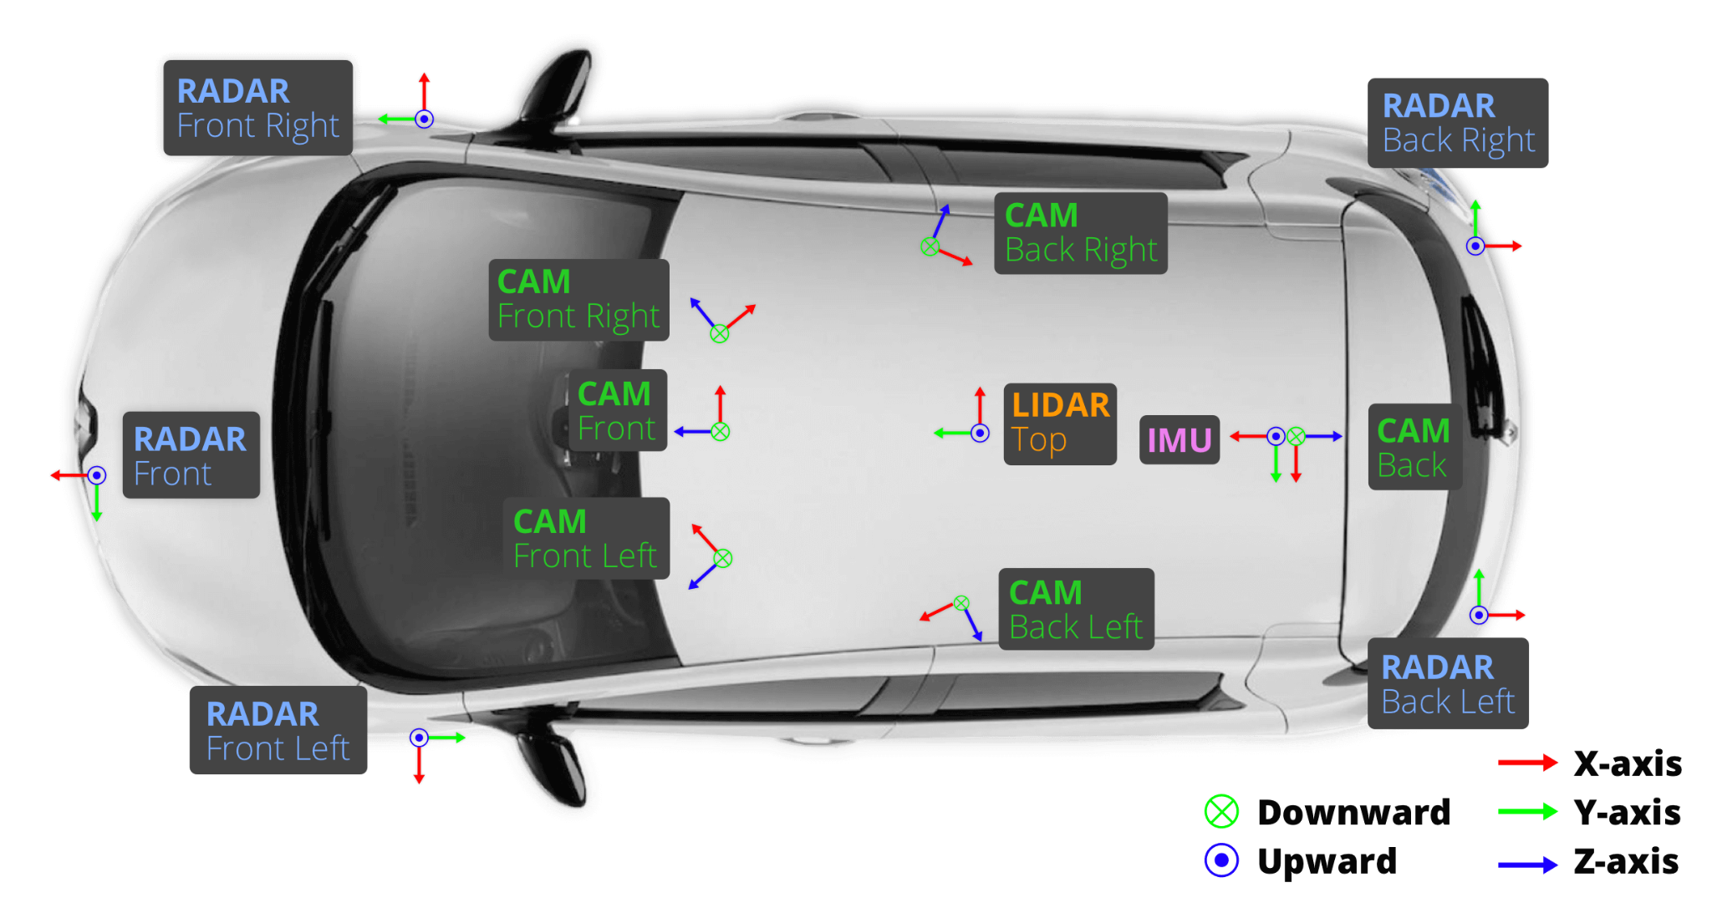
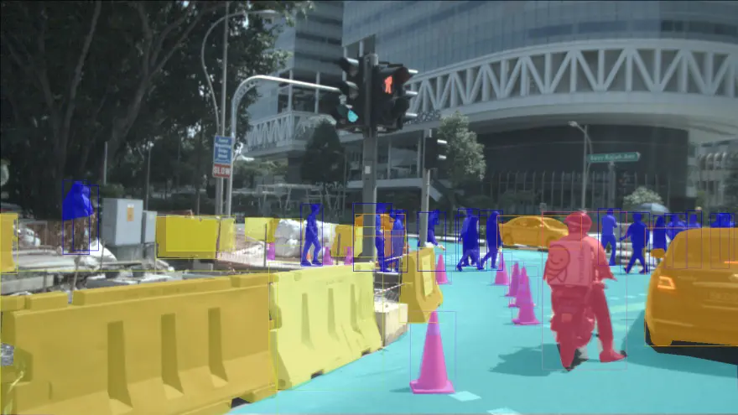
Dataset Overview - nuImages
nuImages is a subset of nuScenes, a public large-scale autonomous driving dataset developed by Motional
93k 2D annotated images mined for diversity
Full sensor suite (1x LIDAR, 5x RADAR, 6x camera, IMU, GPS)
800k annotated foreground objects with 2D bounding boxes and instance masks
Notes:
Motional created the nuScenes dataset to support public research into computer vision and autonomous driving
nuImages is a subset of nuScenes. a large-scale autonomous driving dataset with image-level 2d annotations. It features:
● (~150h of driving)
● 1000 driving scenes from 2 diverse cities: Boston and Singapore
● 800k annotated foreground objects with 2d bounding boxes and instance masks
● 100k 2d image segmentation masks for background classes
6 cameras capture challenging driving scenarios during diverse times and weather conditions

Slide 14

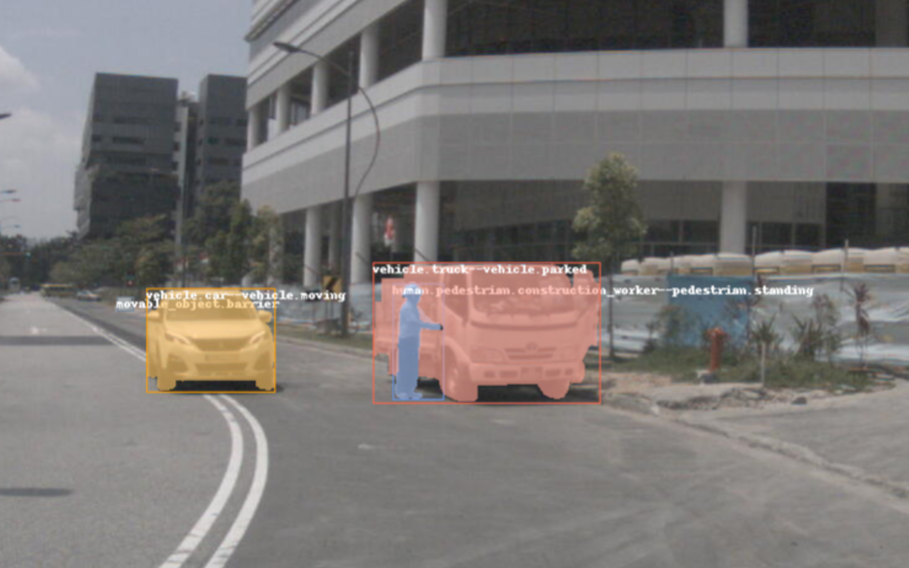
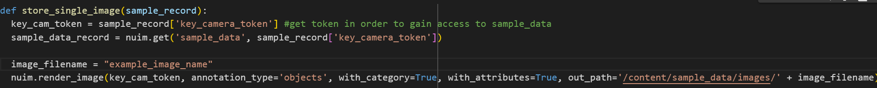
[Insert image and/or code snippet]
Example of nuImages
Category
Attribute
Category
Attribute
Notes:
Example of nuImages annotations under the hood
2D Bounding Box
Segmentation masks for objects detected
Category Annotation
Attribute Annotation
Not pictured: segmentation masks or annotations for surface objects (e.g. road)
We can leverage this information to convert annotation data into XML format
However, for our modeling purposes, we render/download our images with masks and annotations ‘OFF’ (just plain image)

Slide 15
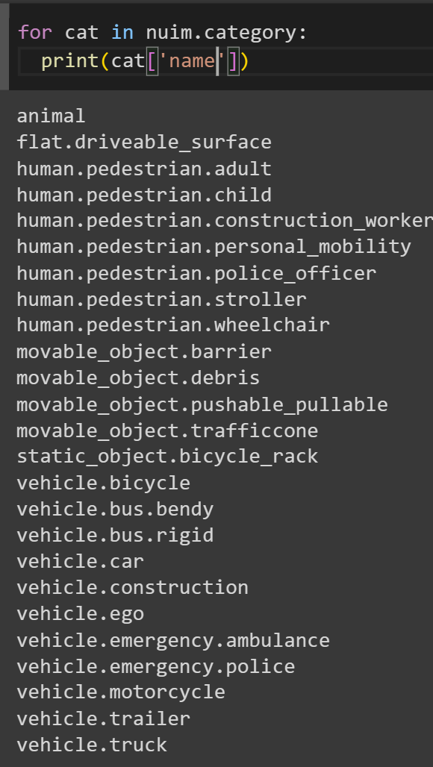
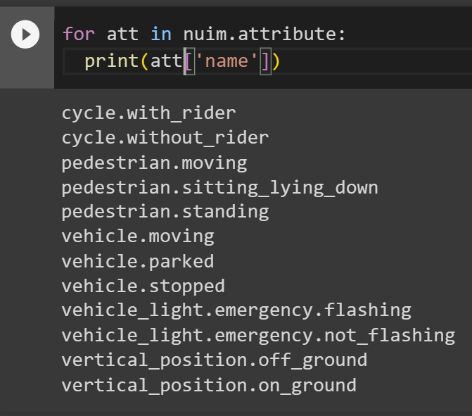
Data Selection
Data already cleaned
Features, annotations and attributes
Only want pedestrians and cyclists
Notes:
This information also allows us to filter for images that only contain pedestrians and cyclists (with rider) to fit our problem scope
If an image does not contain the category or attribute highlighted in the green square, than we ignore it,
This way we are condensing an already huge dataset into something a lot more manageable for our first model iterations

Slide 16
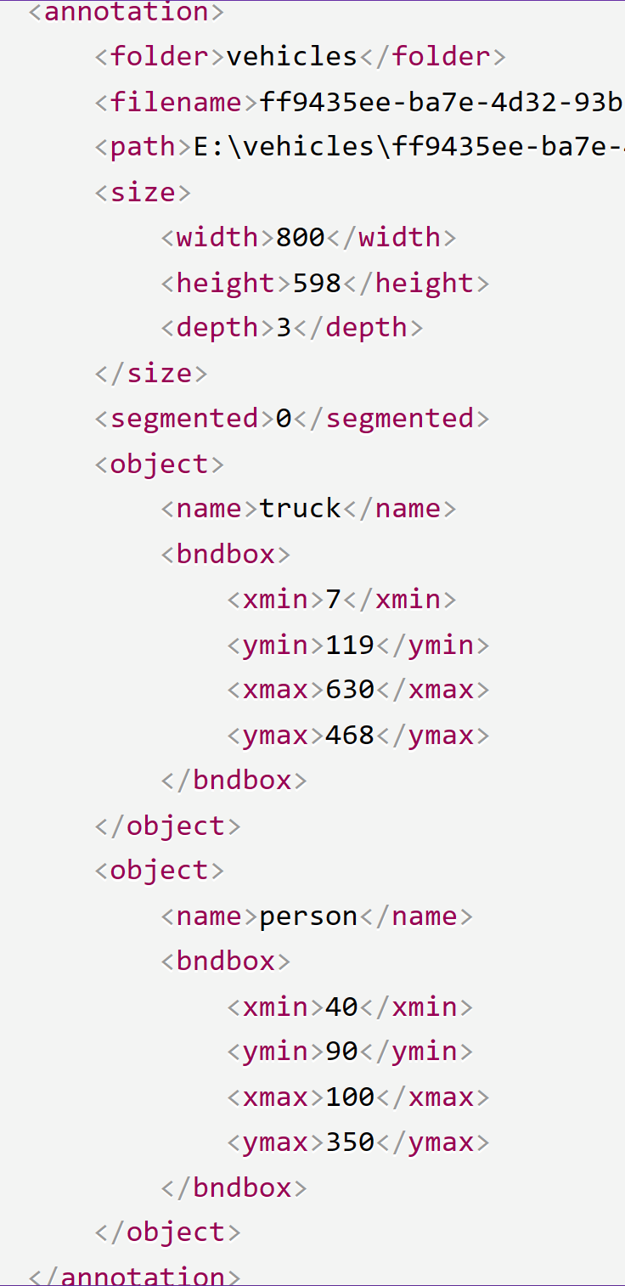
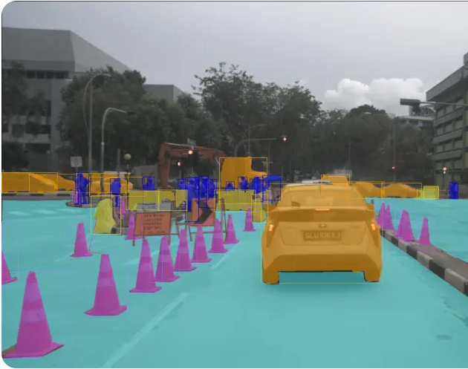
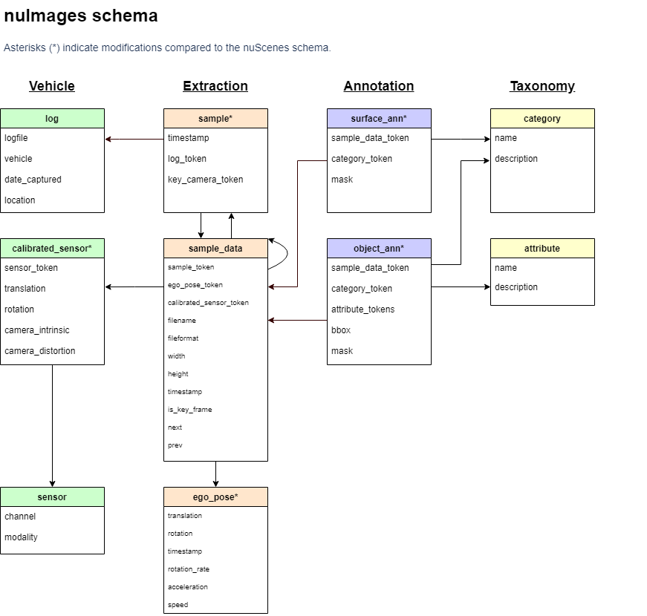
Converting into XML format
Pascal VOC XML
Notes:
Motivation:
Pascal VOC XML - The annotation format originally created for the Visual Object Challenge (VOC) has become a common interchange format for object detection labels
In contrast to csv commonly used for tabular data, XML:
can have one to many relations in multi-levels in XML data representation
is arguably more readable than CSV
And there are standard parsers available everywhere,
and that XML compresses quite good
Later, Vanessa will discuss how we convert our XML annotation data to TFRecords to perform Transfer Learning in Tensorflow
Objective:
Take Pascal VOC XML format (right), find corresponding items in provided nuImages dataset annotations
Navigating the nuImages Schema (left)
Get coordinates of the bounding boxes
Label name of annotation
Dimensions of image (anticipate all will be same size in the end)
Properly encode local/relative path
Preserve filename
Please expand and read!
In this section, you might choose to include slides to cover (these are just options to consider):
- "Dataset Overview"
- "Data Collection"
- "Exploratory Data Analysis (EDA)"
- "Data Selection"
- "Data Cleaning"
- "Text Preprocessing" (for NLP projects)
- "Feature Selection"
- "Feature Engineering"
- "Data Transformation"
- "Correlation Analysis"
- Etc!

Slide 17
Transfer Learning & Foundation Model

Slide 18
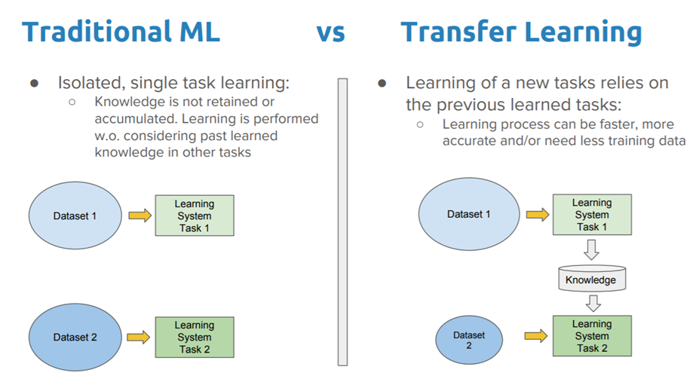
Why Transfer Learning?
Notes:
To build our model, we decided to employ the use of Transfer Learning. Now, what is transfer learning? It is a machine learning method where a pre-existing model is used and modified to fit to a different dataset according to the objective of the project. In our case, we explored the use of objection detection models in order to classify images of objects in our dataset, which Elena will go into a bit later on. There are many pros to using transfer learning vs. a more traditional model building structure. As you can see from the image here, while traditional learning is limited to a single task specific to only 1 project and dataset, transfer learning uses previously learned techniques from other datasets. By using this model, we are essentially compounding the knowledge of the model, which will result in a process that can be faster, more accurate and would perhaps need less training data.

Slide 19
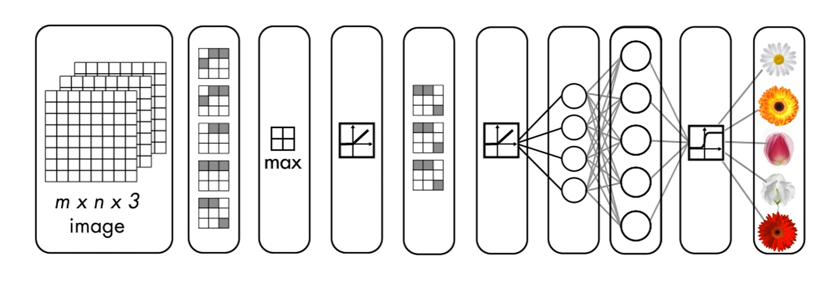
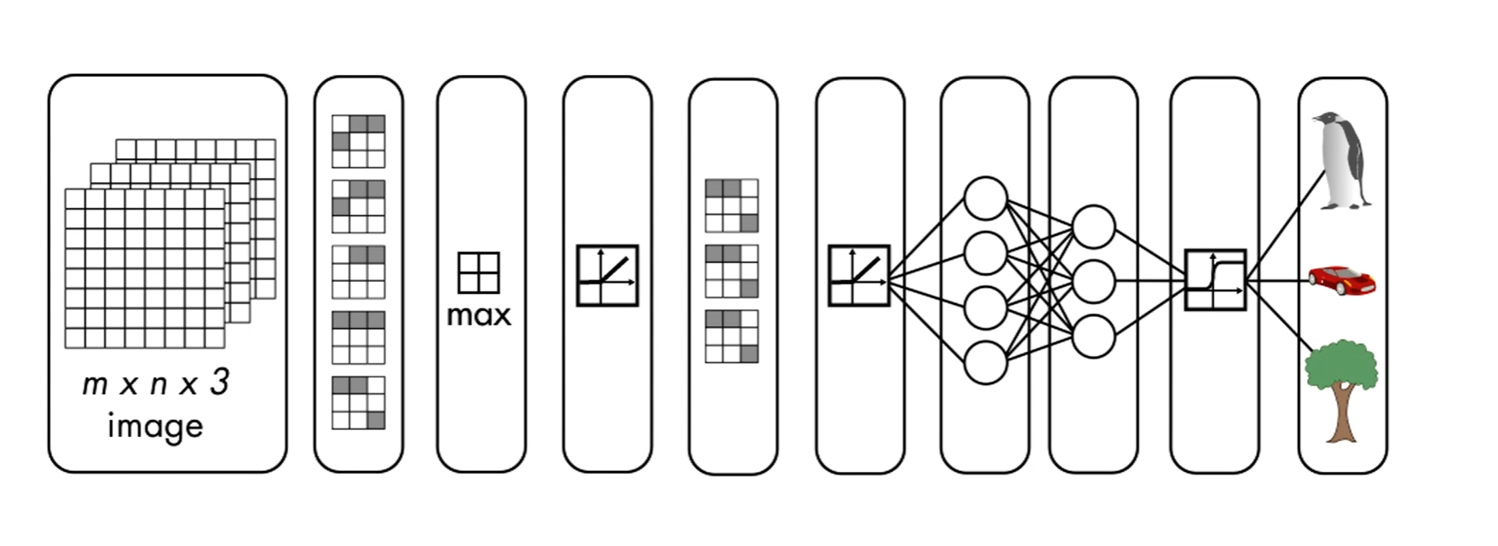
Visual Representation of Transfer Learning
Take a pre-trained Network
Modify and re-train it on new data
Notes:
While training from scratch offers more flexibility than transfer learning, transfer learning offers almost as much flexibility as training a model from scratch, while significantly minimizing the effort
Here is a more visual representation of transfer learning. As we know, to train a neural network there needs to be an input layer, several hidden layers and an output layer. To modify the model to our dataset, we modified the layers instead of adding to the number of layers, thereby modifying the output as well.
Image credits to MATLAB Deep Learning Onramp - What is Transfer Learning?

Slide 20
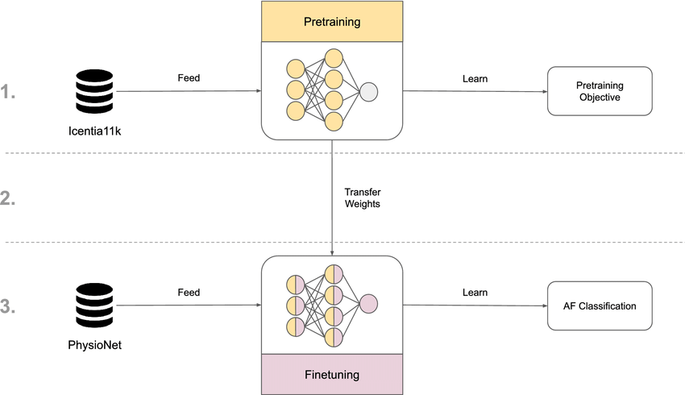
Overview of Transfer Learning
Notes:
This is an example from a paper published in Nature which uses Transfer Learning to classify data from a electrocardiogram. They use a slightly different process than us as in the first step. They train a convolutional neural network to pretrain the model on the original dataset that first classifies heart rate, while we used an objection detection that was already pretrained on different sets of data. The output of the training and the weights are transferred to a new CNN model, where they fine tune the model and run it on a specialized dataset that classifies Arythmia specifically. If we were to draw parallels to our own model, we ran our new object detection model onto the nuImages dataset in order to classify pedestrians.

Slide 21
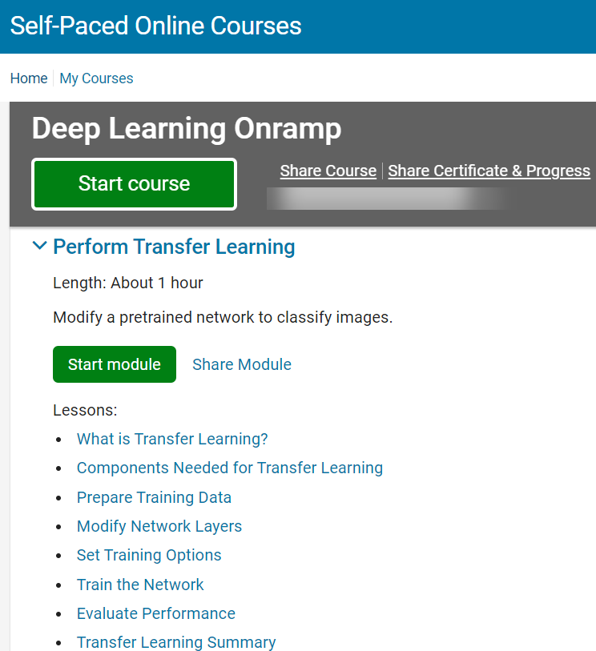
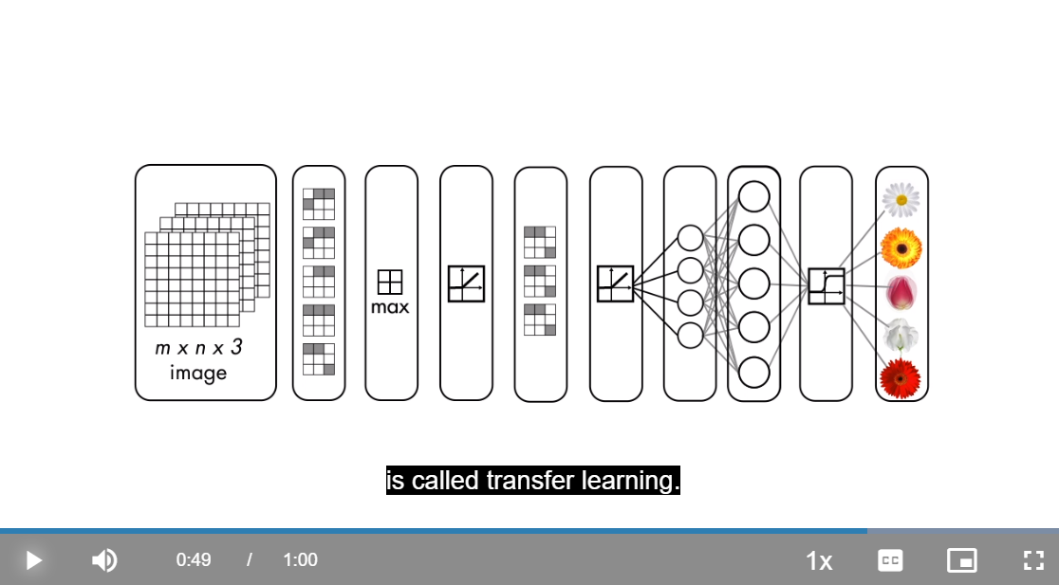
Deep Learning Onramp was useful to get acquainted with Transfer Learning
Notes:
Here I want to highlight how useful the Deep Learning Onramp was to help us understand the concepts behind transfer learning. Given we were all new to Deep Learning, this training was a great way to help us ramp up and grasp concepts more quickly.

Slide 22
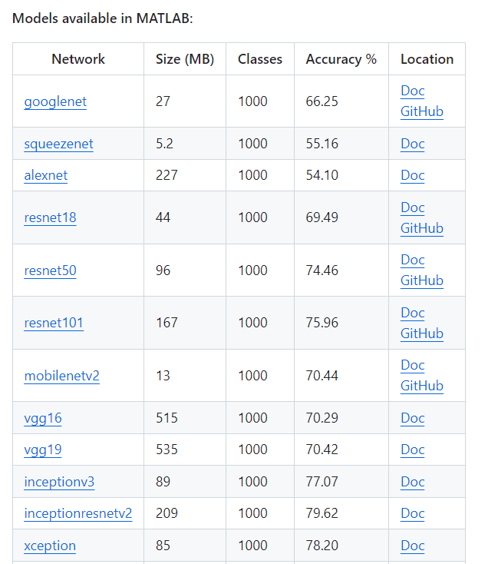
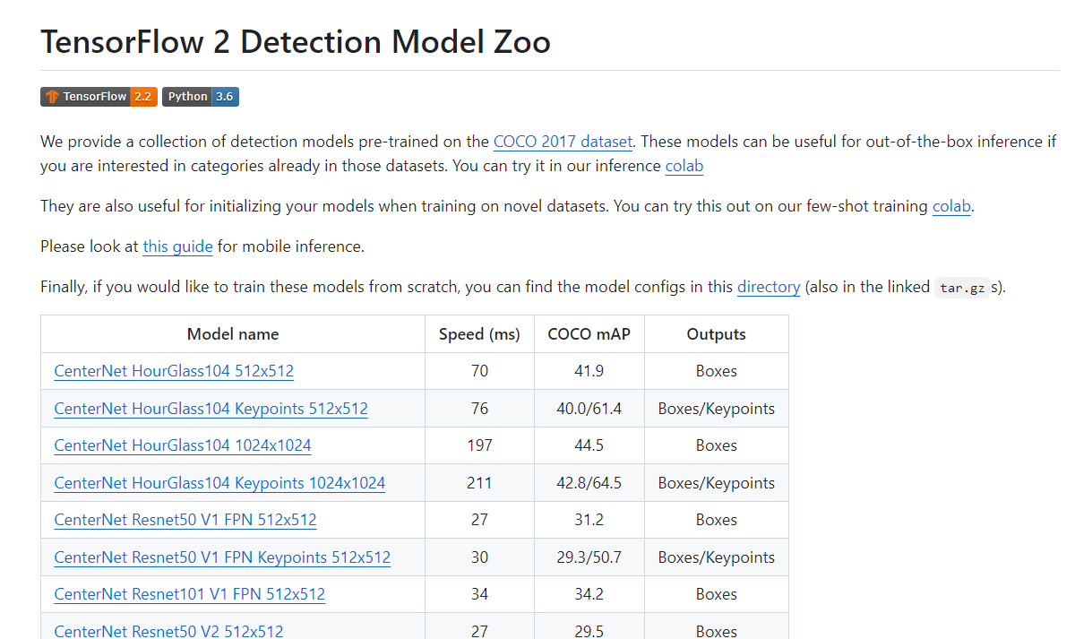
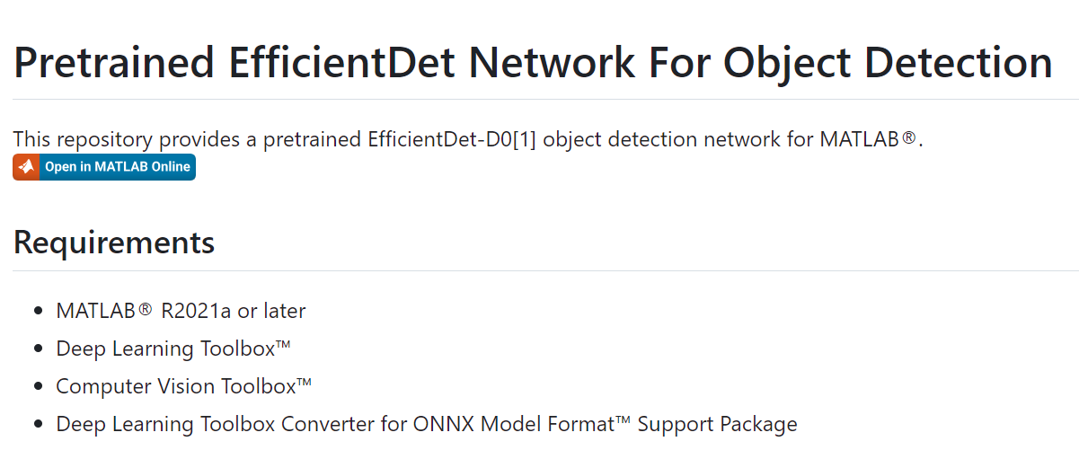
Model Hubs enable access to several pretrained models
MATLAB Deep Learning Model Hub
TensorFlow 2 Model Zoo
Notes:
So, we knew we wanted to use pretrained models to do transfer learning and train an algorithm that could identify only the pedestrians and cyclists in the images. We had several options to choose from: On one hand, we had a few models available in MATLAB and also TensorFlow 2 has a comprehensive set of detection models. We decided to continue our testing with TensorFlow model architectures.

Slide 23
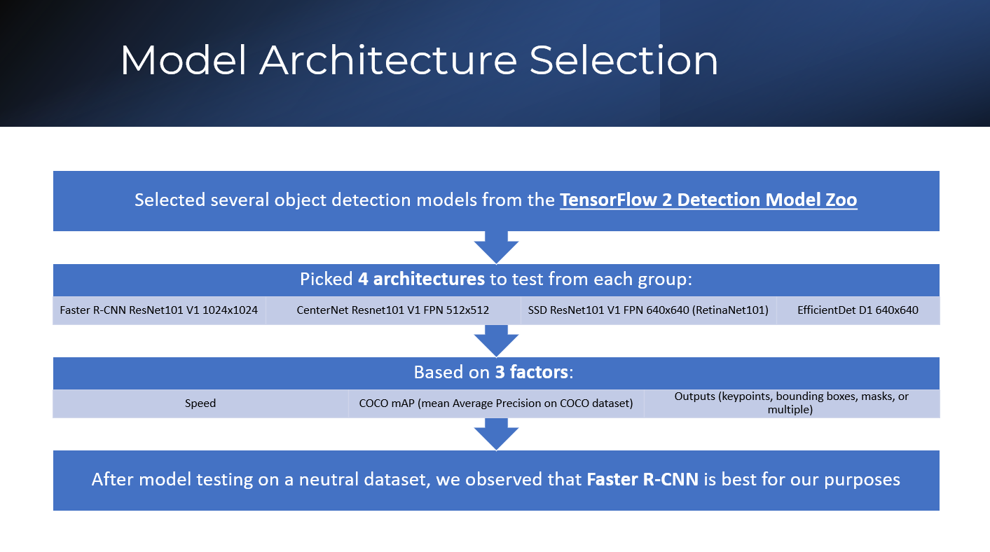
Notes:
Pedestrian detection based on improved Faster RCNN algorithm | IEEE Conference Publication | IEEE Xplore
A Faster RCNN-Based Pedestrian Detection System | IEEE Conference Publication | IEEE Xplore An Improved Faster R-CNN Algorithm for Pedestrian Detection | IEEE Conference Publication | IEEE Xplore
Faster R-CNN vs YOLO vs SSD — Object Detection Algorithms | by Abonia Sojasingarayar | IBM Data Science in Practice | Medium
https://www.labellerr.com/blog/how-object-detection-works-in-self-driving-cars-using-deep-learning/#:~:text=Faster%2DRCNN%3A%20The%20main%20insight,of%2Dthe%2Dart%20accuracy.
https://towardsdatascience.com/r-cnn-fast-r-cnn-faster-r-cnn-yolo-object-detection-algorithms-36d53571365e
Vanessa
Faster R-CNN Explained for Object Detection Tasks | Paperspace Blog
R-CNN, Fast R-CNN, Faster R-CNN, YOLO — Object Detection Algorithms | by Rohith Gandhi | Towards Data Science
Faster RCNN Python | Faster R-CNN For Object Detection (analyticsvidhya.com)
Vanessa

Slide 24
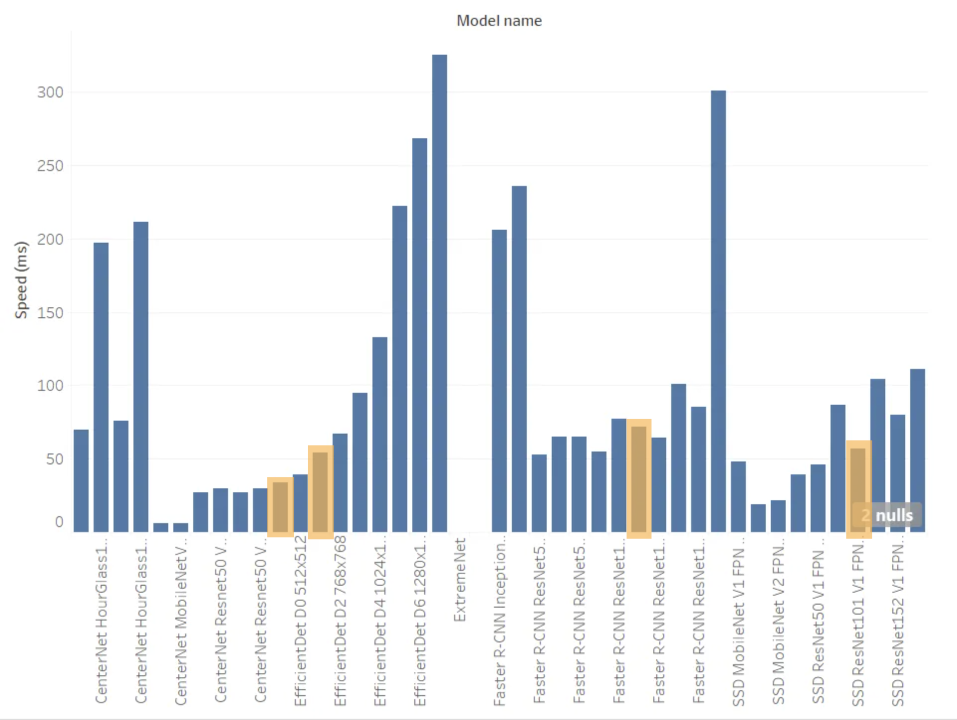
Model Comparison
Comparison of speed across all of the architectures
Model Name | Speed (ms) | mAP [precision] | Outputs
Faster R-CNN ResNet101 V1 1024x1024 | 72 | 37.1 | Boxes
CenterNet Resnet101 V1 FPN 512x512 | 34 | 34.2 | Boxes
EfficientDet D1 640x640 | 54 | 38.4 | Boxes
SSD ResNet101 V1 FPN 640x640 (RetinaNet101) | 57 | 35.6 | Boxes
Model name | Speed (ms) | COCO mAP | Outputs
CenterNet HourGlass104 512x512 | 70 | 41.9 | Boxes
CenterNet HourGlass104 Keypoints 512x512 | 76 | 40.0/61.4 | Boxes/Keypoints
CenterNet HourGlass104 1024x1024 | 197 | 44.5 | Boxes
CenterNet HourGlass104 Keypoints 1024x1024 | 211 | 42.8/64.5 | Boxes/Keypoints
CenterNet Resnet50 V1 FPN 512x512 | 27 | 31.2 | Boxes
CenterNet Resnet50 V1 FPN Keypoints 512x512 | 30 | 29.3/50.7 | Boxes/Keypoints
CenterNet Resnet101 V1 FPN 512x512 | 34 | 34.2 | Boxes
CenterNet Resnet50 V2 512x512 | 27 | 29.5 | Boxes
CenterNet Resnet50 V2 Keypoints 512x512 | 30 | 27.6/48.2 | Boxes/Keypoints
CenterNet MobileNetV2 FPN 512x512 | 6 | 23.4 | Boxes
CenterNet MobileNetV2 FPN Keypoints 512x512 | 6 | 41.7 | Keypoints
EfficientDet D0 512x512 | 39 | 33.6 | Boxes
EfficientDet D1 640x640 | 54 | 38.4 | Boxes
EfficientDet D2 768x768 | 67 | 41.8 | Boxes
EfficientDet D3 896x896 | 95 | 45.4 | Boxes
EfficientDet D4 1024x1024 | 133 | 48.5 | Boxes
EfficientDet D5 1280x1280 | 222 | 49.7 | Boxes
EfficientDet D6 1280x1280 | 268 | 50.5 | Boxes
EfficientDet D7 1536x1536 | 325 | 51.2 | Boxes
SSD MobileNet v2 320x320 | 19 | 20.2 | Boxes
SSD MobileNet V1 FPN 640x640 | 48 | 29.1 | Boxes
SSD MobileNet V2 FPNLite 320x320 | 22 | 22.2 | Boxes
SSD MobileNet V2 FPNLite 640x640 | 39 | 28.2 | Boxes
SSD ResNet50 V1 FPN 640x640 (RetinaNet50) | 46 | 34.3 | Boxes
SSD ResNet50 V1 FPN 1024x1024 (RetinaNet50) | 87 | 38.3 | Boxes
SSD ResNet101 V1 FPN 640x640 (RetinaNet101) | 57 | 35.6 | Boxes
SSD ResNet101 V1 FPN 1024x1024 (RetinaNet101) | 104 | 39.5 | Boxes
SSD ResNet152 V1 FPN 640x640 (RetinaNet152) | 80 | 35.4 | Boxes
SSD ResNet152 V1 FPN 1024x1024 (RetinaNet152) | 111 | 39.6 | Boxes
Faster R-CNN ResNet50 V1 640x640 | 53 | 29.3 | Boxes
Faster R-CNN ResNet50 V1 1024x1024 | 65 | 31.0 | Boxes
Faster R-CNN ResNet50 V1 800x1333 | 65 | 31.6 | Boxes
Faster R-CNN ResNet101 V1 640x640 | 55 | 31.8 | Boxes
Faster R-CNN ResNet101 V1 1024x1024 | 72 | 37.1 | Boxes
Faster R-CNN ResNet101 V1 800x1333 | 77 | 36.6 | Boxes
Faster R-CNN ResNet152 V1 640x640 | 64 | 32.4 | Boxes
Faster R-CNN ResNet152 V1 1024x1024 | 85 | 37.6 | Boxes
Faster R-CNN ResNet152 V1 800x1333 | 101 | 37.4 | Boxes
Faster R-CNN Inception ResNet V2 640x640 | 206 | 37.7 | Boxes
Faster R-CNN Inception ResNet V2 1024x1024 | 236 | 38.7 | Boxes
Mask R-CNN Inception ResNet V2 1024x1024 | 301 | 39.0/34.6 | Boxes/Masks
Notes:
Speed , mAP, Outputs,
Faster R-CNN ResNet101 V1 1024x1024
72 37.1 Boxes
SSD ResNet101 V1 FPN 640x640 (RetinaNet101)
57 35.6 Boxes
EfficientDet D1 640x640
54 38.4 Boxes
CenterNet Resnet101 V1 FPN 512x512
34 34.2 Boxes

Slide 25
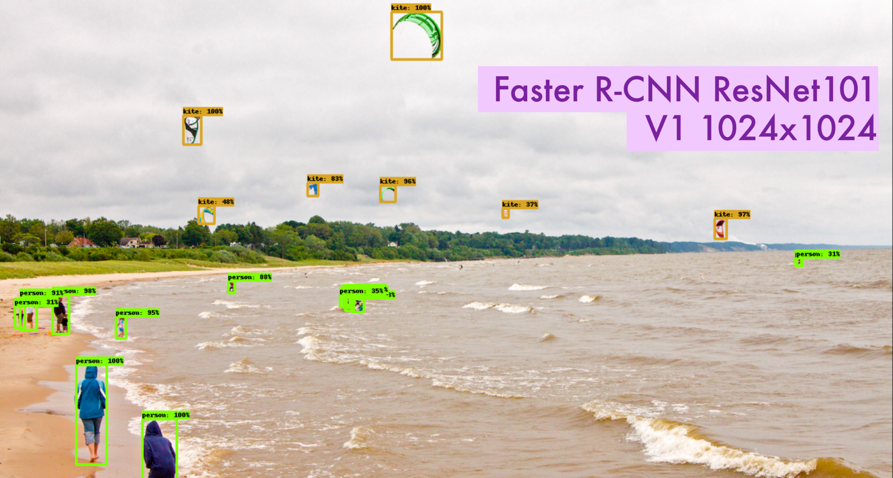
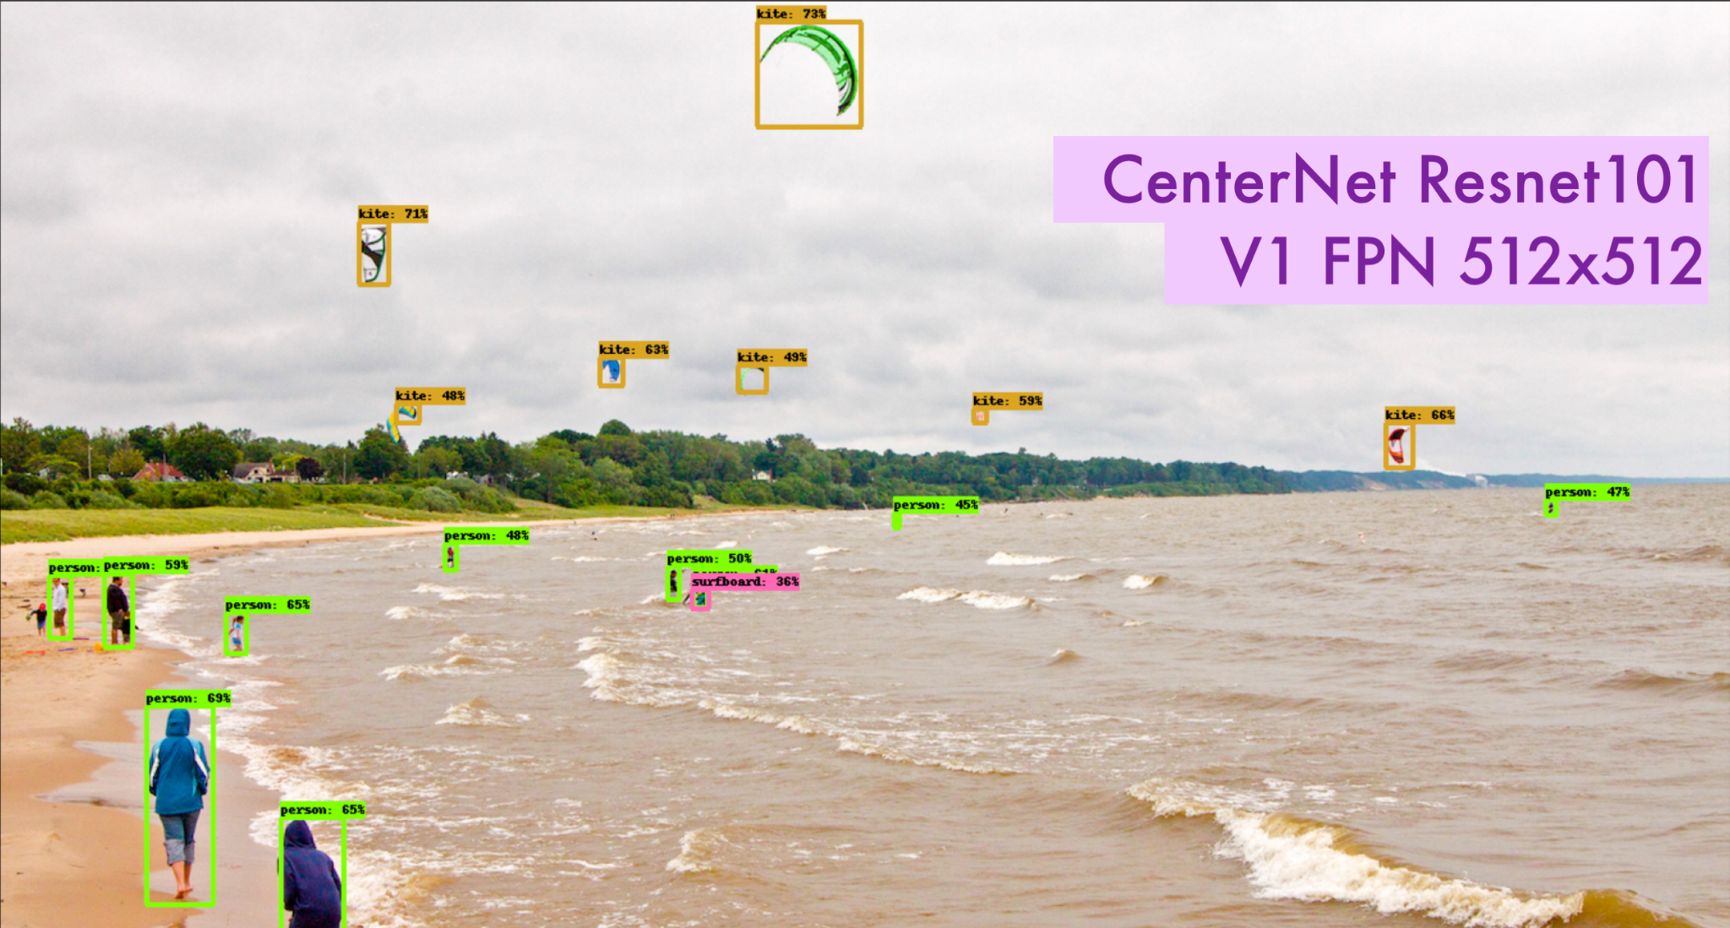
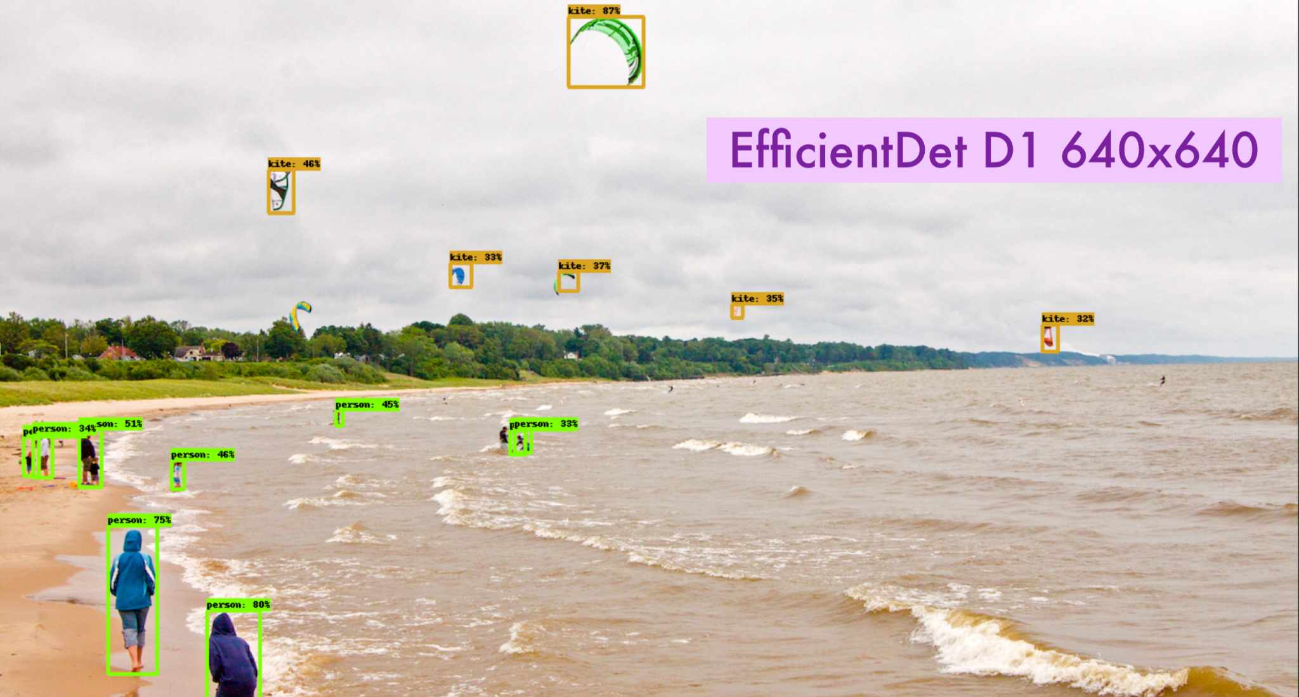
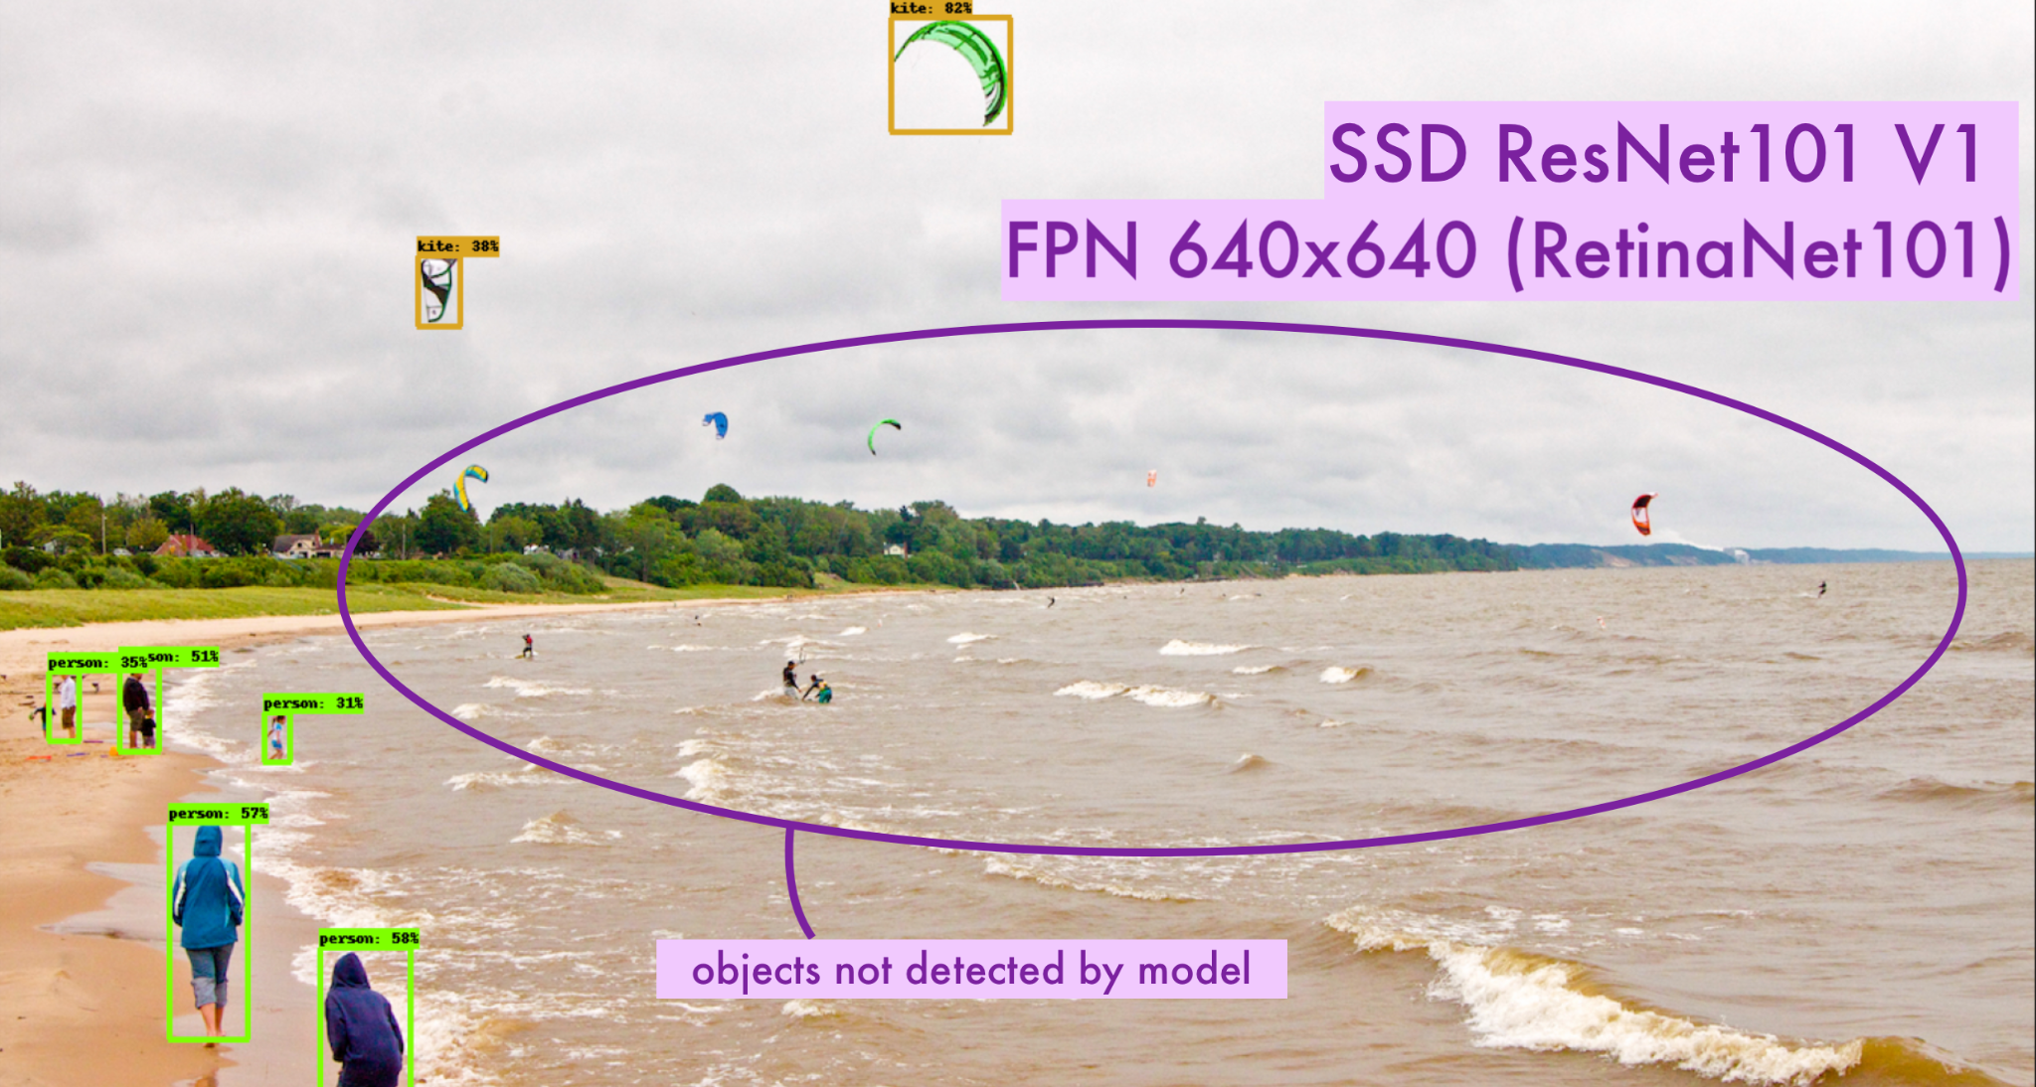
Comparison on beach sample
Notes:
Pedestrian detection based on improved Faster RCNN algorithm | IEEE Conference Publication | IEEE Xplore
A Faster RCNN-Based Pedestrian Detection System | IEEE Conference Publication | IEEE Xplore An Improved Faster R-CNN Algorithm for Pedestrian Detection | IEEE Conference Publication | IEEE Xplore
Faster R-CNN vs YOLO vs SSD — Object Detection Algorithms | by Abonia Sojasingarayar | IBM Data Science in Practice | Medium
https://www.labellerr.com/blog/how-object-detection-works-in-self-driving-cars-using-deep-learning/#:~:text=Faster%2DRCNN%3A%20The%20main%20insight,of%2Dthe%2Dart%20accuracy.
Vanessa

Slide 26
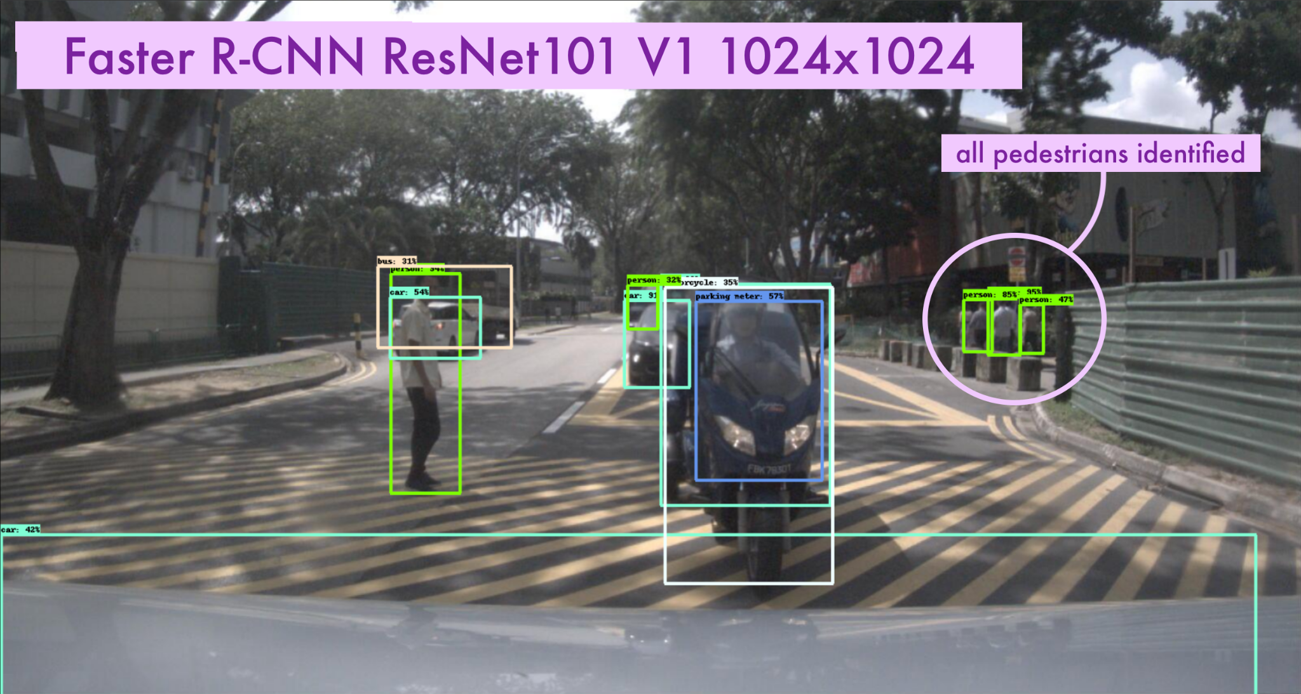
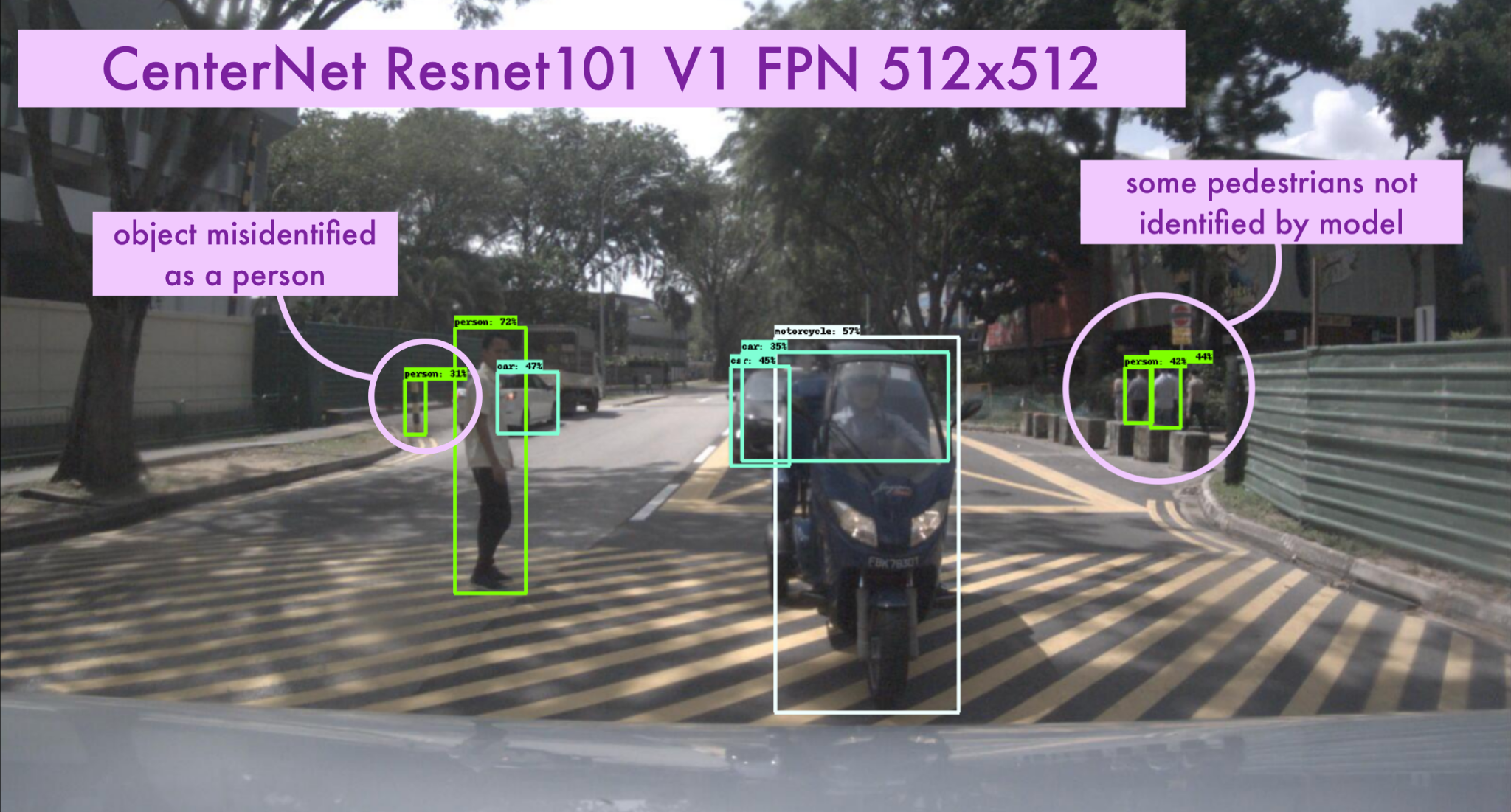
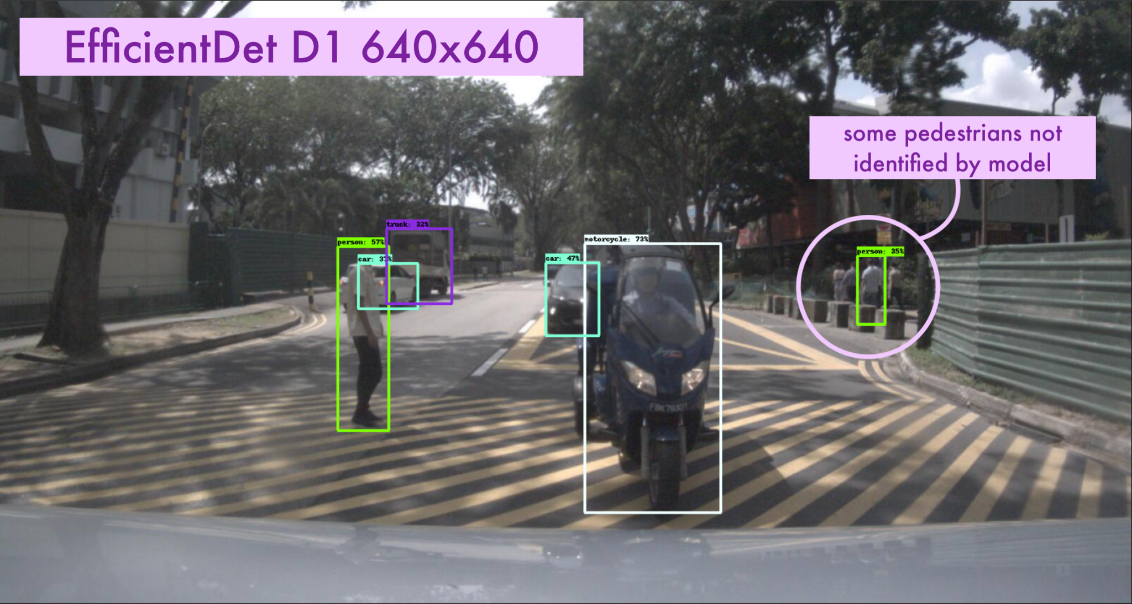
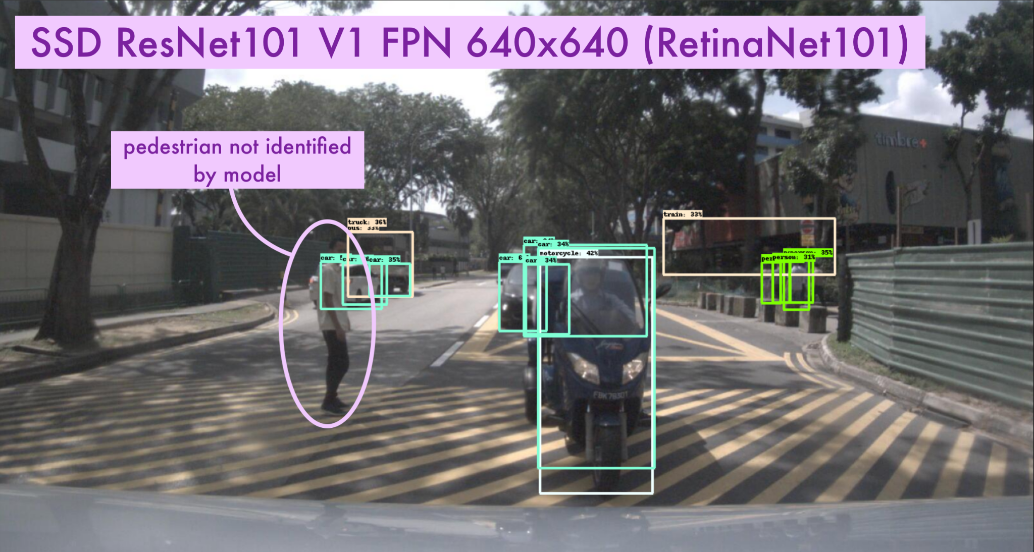
Comparison on nuImages - part 1
Notes:
n003-2018-01-03-12-03-23+0800__CAM_BACK__1514952316316487.jpg

Slide 27
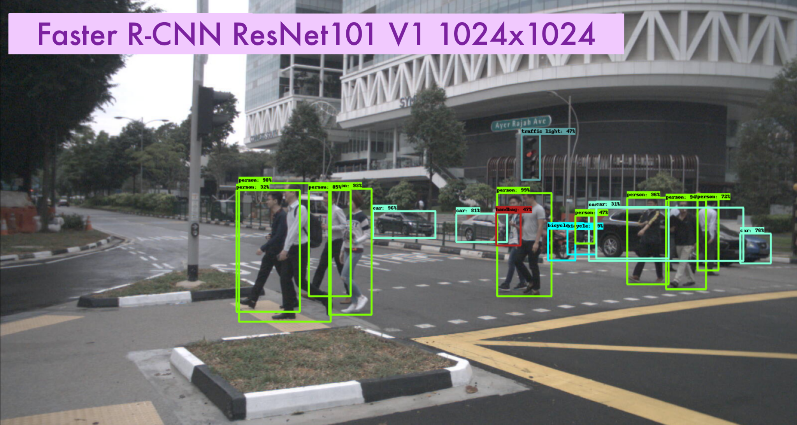
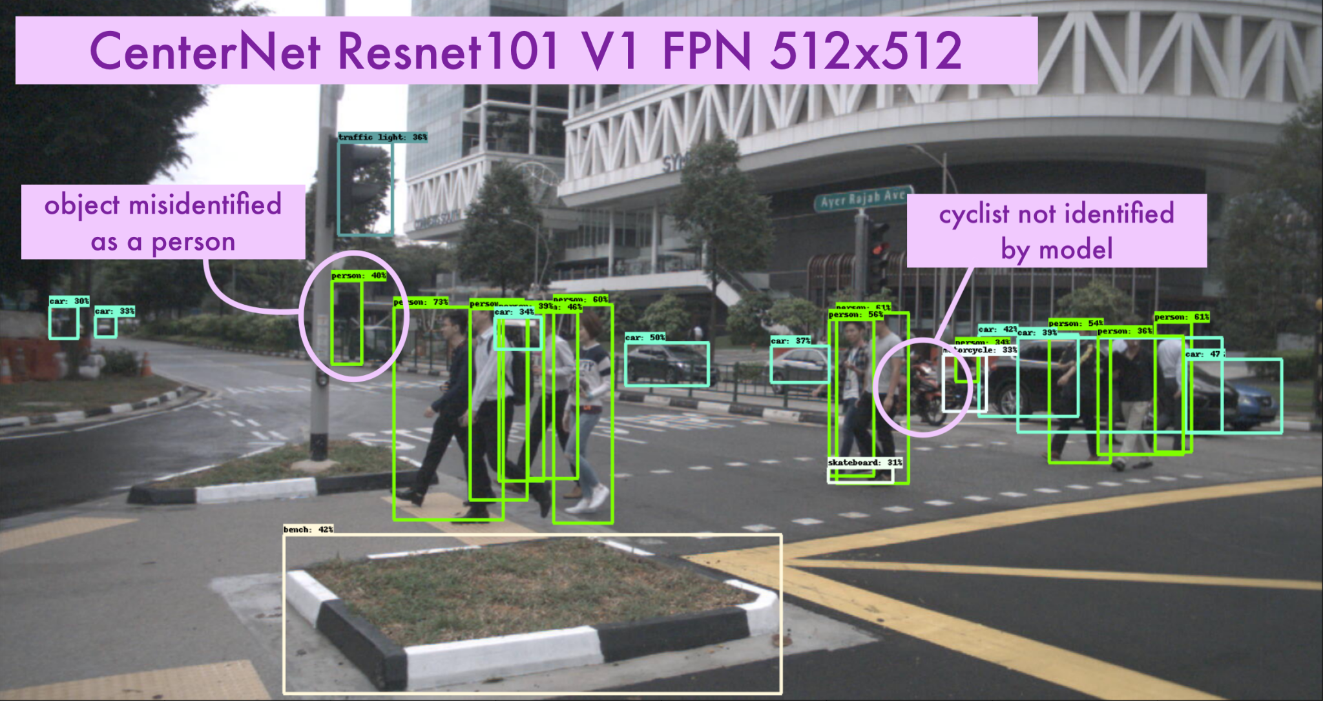
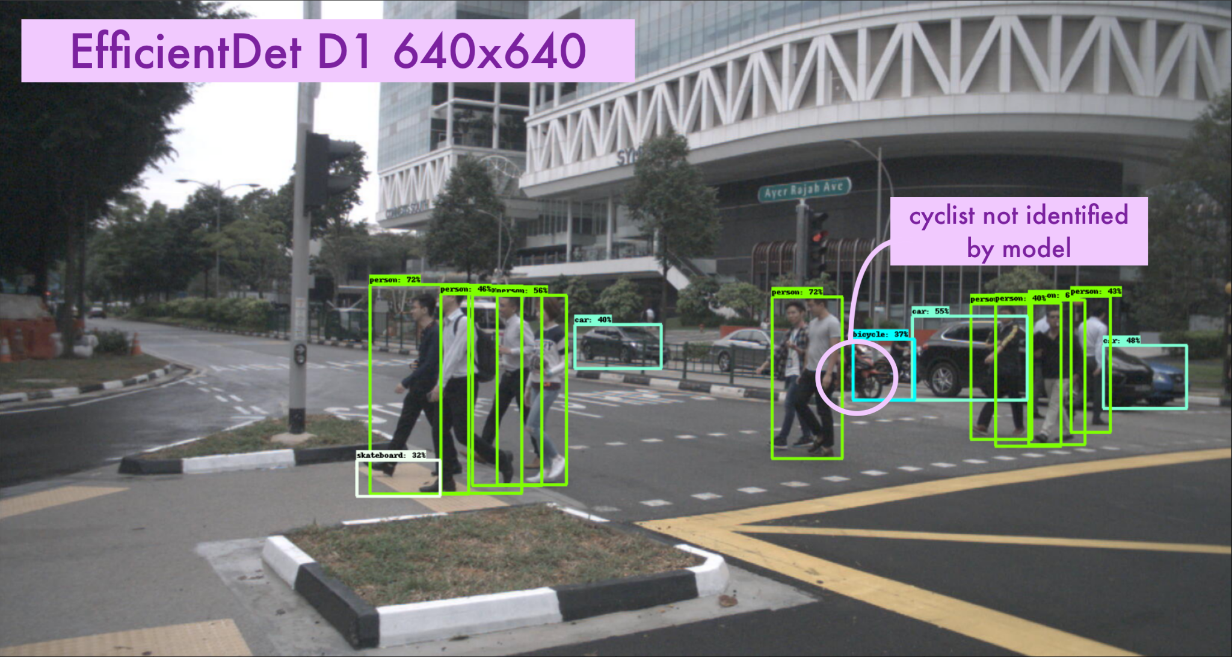
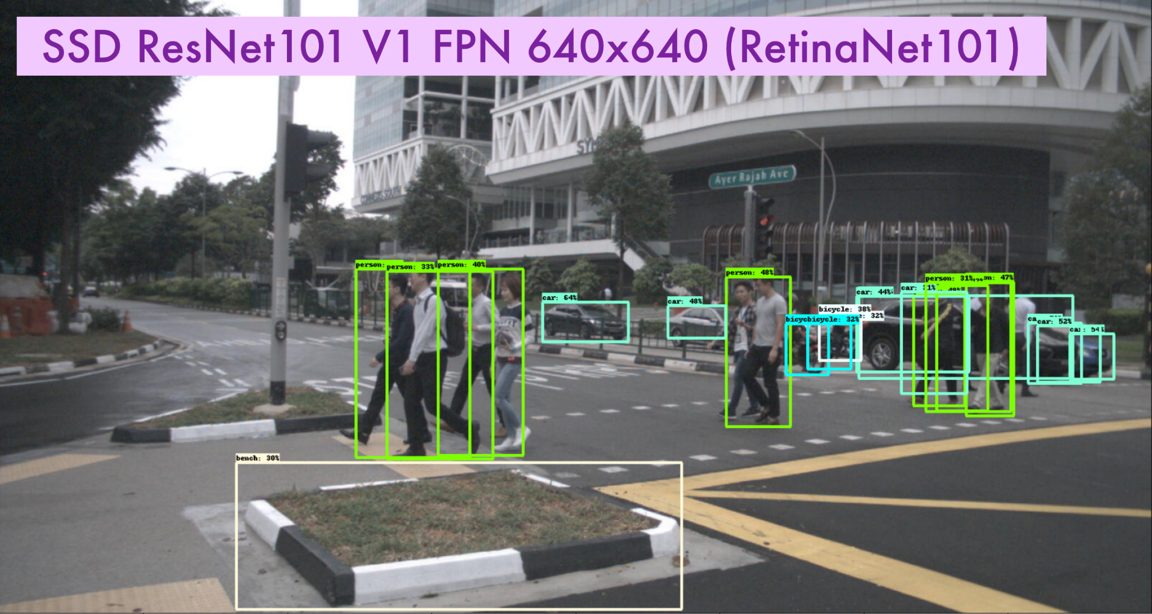
Comparison on nuImages - part 2
Notes:
n013-2018-09-04-13-30-50+0800__CAM_FRONT_LEFT__1536039168104825.jpg

Slide 28
Customizing Pretrained Object Detectors
Existing pre-trained networks for object detection can identify people, bikes and cars, but they provide little to no information to the specifics of the pedestrians (standing, moving, etc.)
Dataset used in this project contains all the additional details needed to customize the detection of pedestrians and people riding bicycles or motorcycles.
Architectures pre-selected can be used in the model training step.
Notes:
So while the objection detection models that Elena went through are amazing, due to several factors, we determined that the transfer learning was essential. The models can identify different objects like bikes and cars, but they provide little or no information on the state of the object. For example, if pedestrians are moving or sitting. The dataset that we use contains all this additional information, and we modified the object detection model to refine it. We used our chosen model to make the training process easier and the model become faster and more accurate to our objective.

Slide 29
Model Training & Evaluation

Slide 30
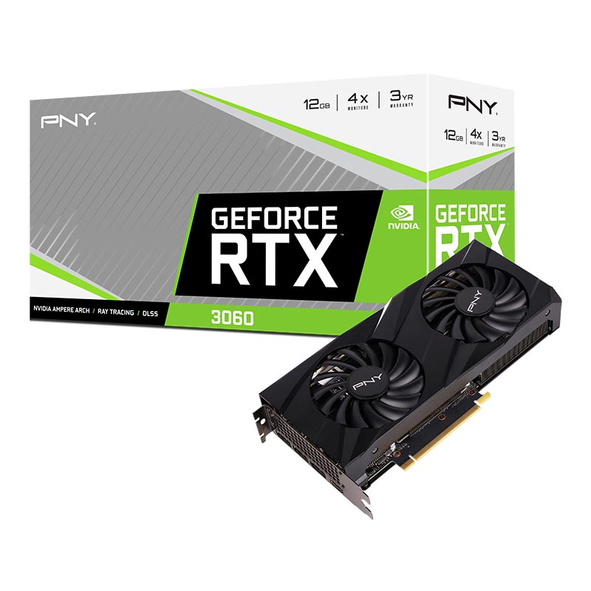

Environments We Utilized

Slide 31
Data Decisions for Training
Moving
500 total images
FRONT CAM
Limited number of images out of the 87k available
Images used from FRONT Cameras only
Must include at least one moving pedestrian or cycle with rider
Notes:
Properly feed annotations into the training

Slide 32
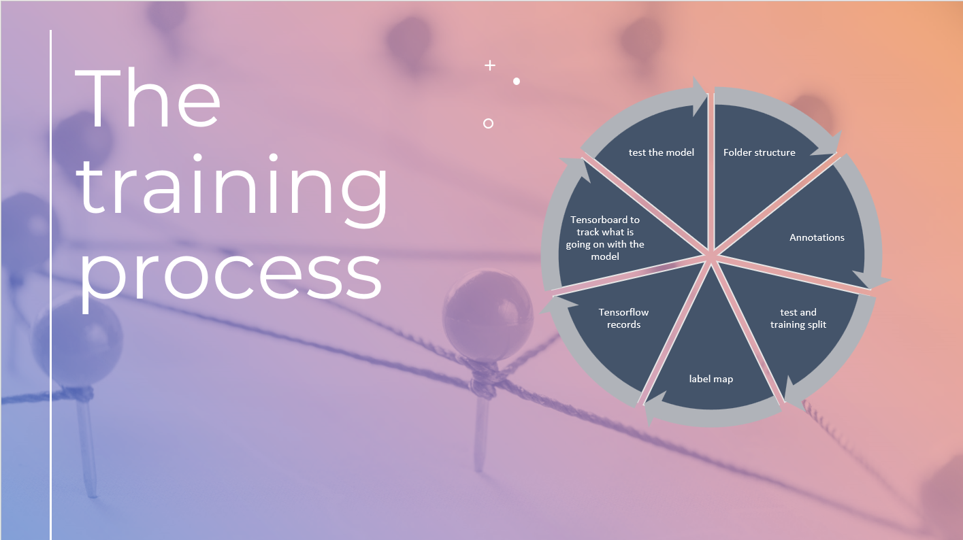

Slide 33
The training process - New Classes for Detection
Examples of classes to train on:
'Human.pedestrian.adult-pedestrian.moving'
'Human.pedestrian.child-pedestrian.moving'
A combination of category and attribute to make the classes distinctive enough. In total, we trained the object detector to detect 10 different types of humans moving in the image.

Slide 34
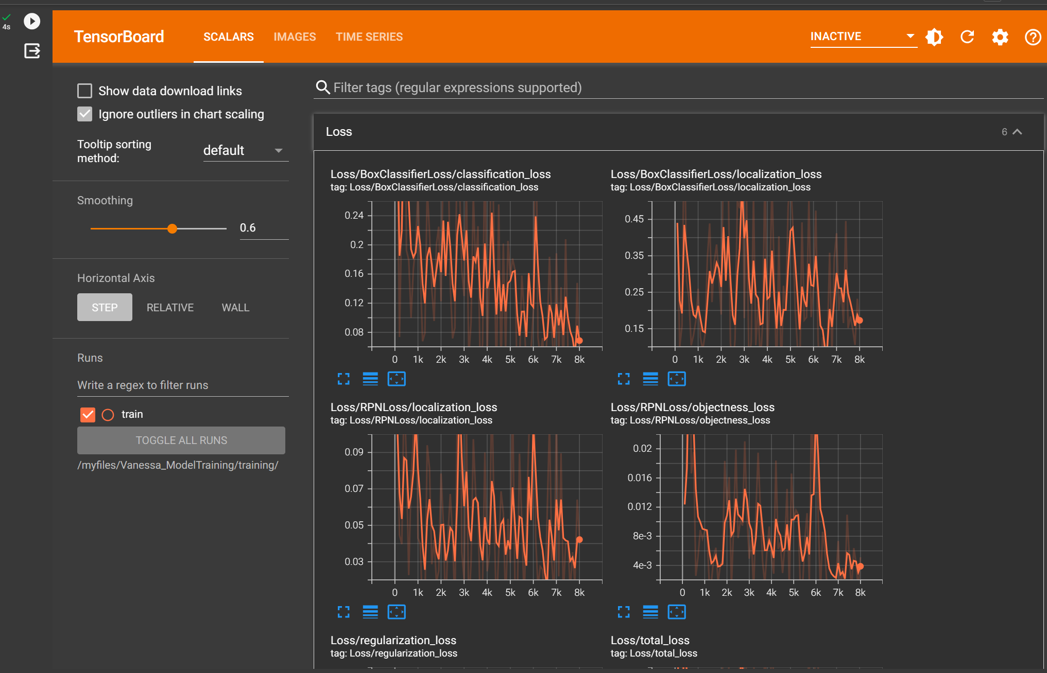
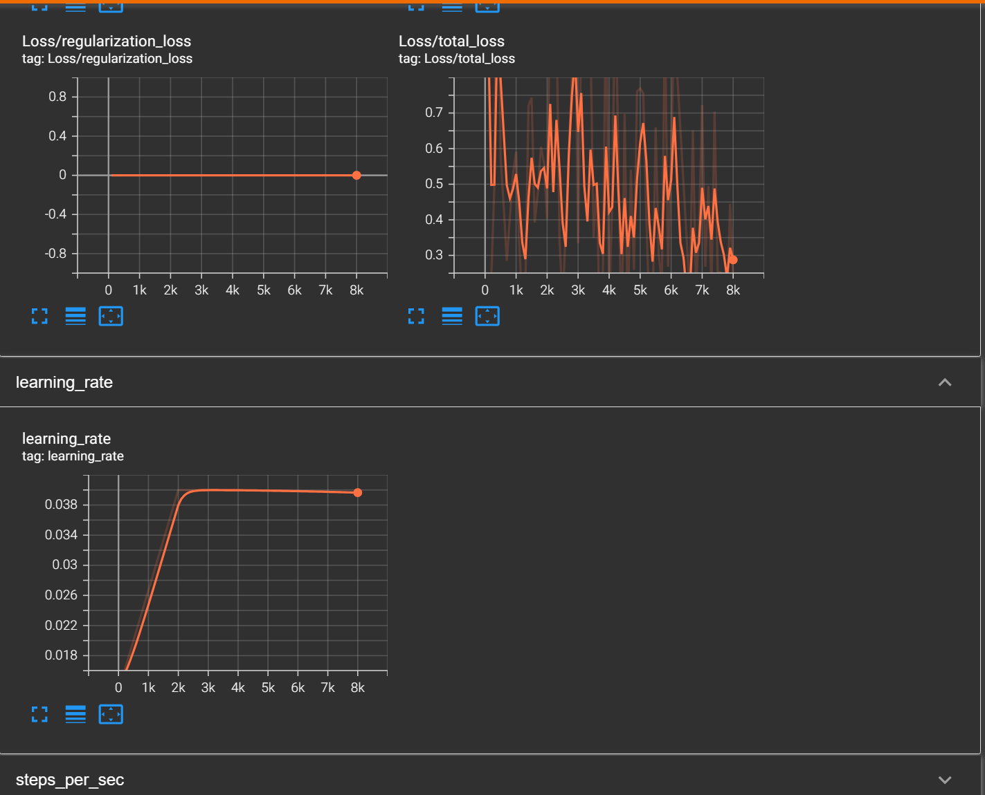
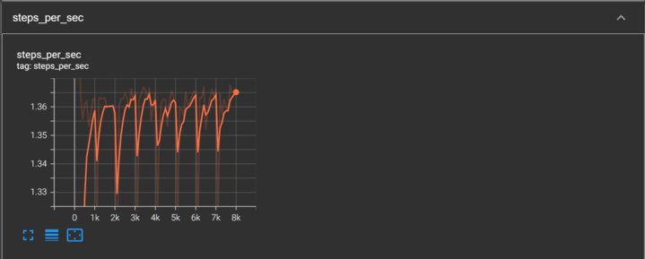
Training Results - Improper Data
Fast RCNN ResNet 101(1024x1024)

Slide 35
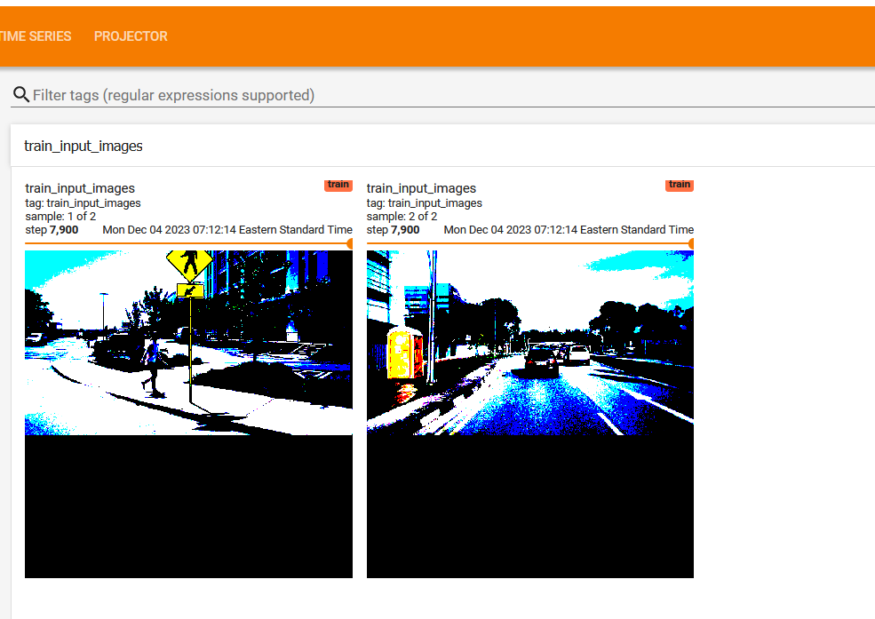
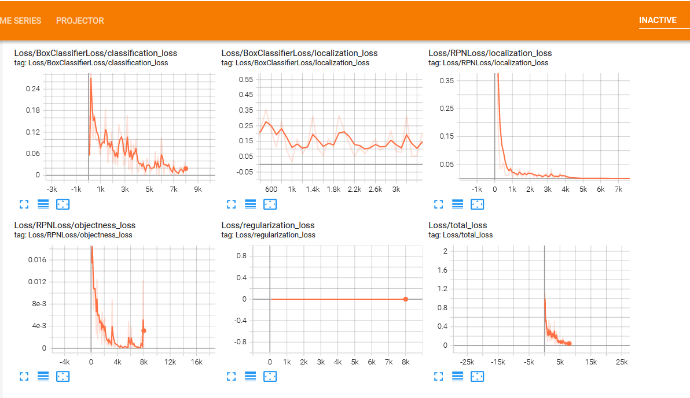
Training Results - First pretrained model
Fast RCNN ResNet 50 (640x640)

Slide 36


Training Results - Second pretrained model
Fast RCNN ResNet 101(1024x1024)

Slide 37

Testing the Model (before detection)

Slide 38

Testing the Model (with model trained #1)

Slide 39

Testing the Model (with model trained #2)

Slide 40



Testing the Model

Slide 41

Notes:
Specializing the pipeline to enable the deployment and training of these models across different environments

Slide 42

Further exploration: Using the model in MATLAB
Using the Deep Learning Toolbox, TensorFlow models can be imported into MATLAB
Puzzle: TensorFlow 2 models with “SavedModel” format into MATLAB - How best to import models with this format?
Notes:
The next step is to use the model in MATLAB. We learned that it’s possible to import tensorflow models in MATLAB, so we can use the custom object detection without having to retrain the model. In our tests we discovered that TensorFlow 2 models with the “SavesModel” format return several warnings from MATLAB, so we want to explore further.

Slide 43


Next Step: Access LIDAR Data from nuScenes
From Python we can export the LIDAR data as PCD (point cloud data) and open the results in MATLAB (using the MATLAB Engine API) for further exploration
Notes:
Also, we wanted to test accessing the LIDAR data. Moving into the nuScenes dataset, it’s possible to get all the lidar data for a given scene and convert the bin files to point cloud data format. From Python we can then open a MATLAB session using the MATLAB Engine and opening the lidar Viewer.

Slide 44

Next Step: Access LIDAR Data from nuScenes
From Python we can export the LIDAR data as PCD (point cloud data) and open the results in MATLAB (using the MATLAB Engine API) for further exploration
Notes:
The lidar viewer allow us to inspect different clusters in the data recorded by the sensor. All the data can in turn help us train a deep learning model for the lidar data and then check how well it detects pedestrians compared to images.

Slide 45
Final Thoughts

Slide 46



Summary
Fine-tune an object detection model that demonstrates high accuracy in detecting pedestrians and cyclists
Used 15GB of annotated image data from nuImages
Had to convert these into XML format in order to use TF records
Transfer Learning, object detection model zoo
Training on Tufts HPC

Slide 47
Next Steps: Using the model in MATLAB
Using the Deep Learning Toolbox, we can now import the trained TensorFlow model into MATLAB
In MATLAB, use the Lidar Toolbox, Automated Driving Toolbox and Sensor Fusion Toolbox to use both camera images and LIDAR data from the nuScenes dataset
This integration with MATLAB would enable a more precise pedestrian detection, as well as getting depth information

Slide 48
Potential Next Steps
Using LIDAR and distance data, classify the safety of the pedestrians according to how far they are from the car, where they are in relation to the street, etc.
Involves neural network to learn intent of pedestrians and cyclists
This open dataset is very comprehensive and can help computer science and engineering students learn more about deep learning and using multiple sensors to make better predictions.

Slide 49
What We Learned
Image processing & computer vision
Deep Learning (both in MATLAB and Python)
TensorFlow
Object Detection Models
XML format (data infrastructure & pipelining)
Transfer Learning
HPC
Teamwork / delegation / collaboration / time management
Accountability / keeping everyone on the same page
Working with people from different experience levels

Slide 50

Questions?

